Slide 1
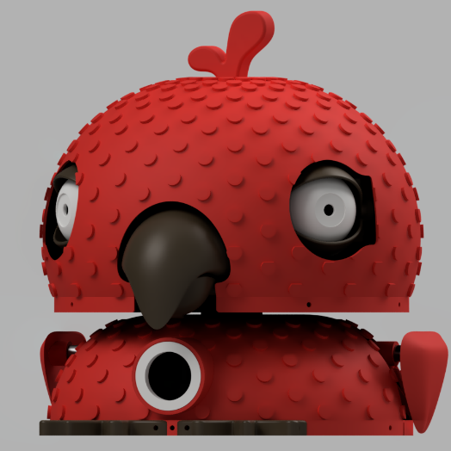
PROJ300 VIVA
Interactive Parrot Robot with Face Tracking, Emotion Recognition and Voice Repetition
By Emma Shah

Slide 2
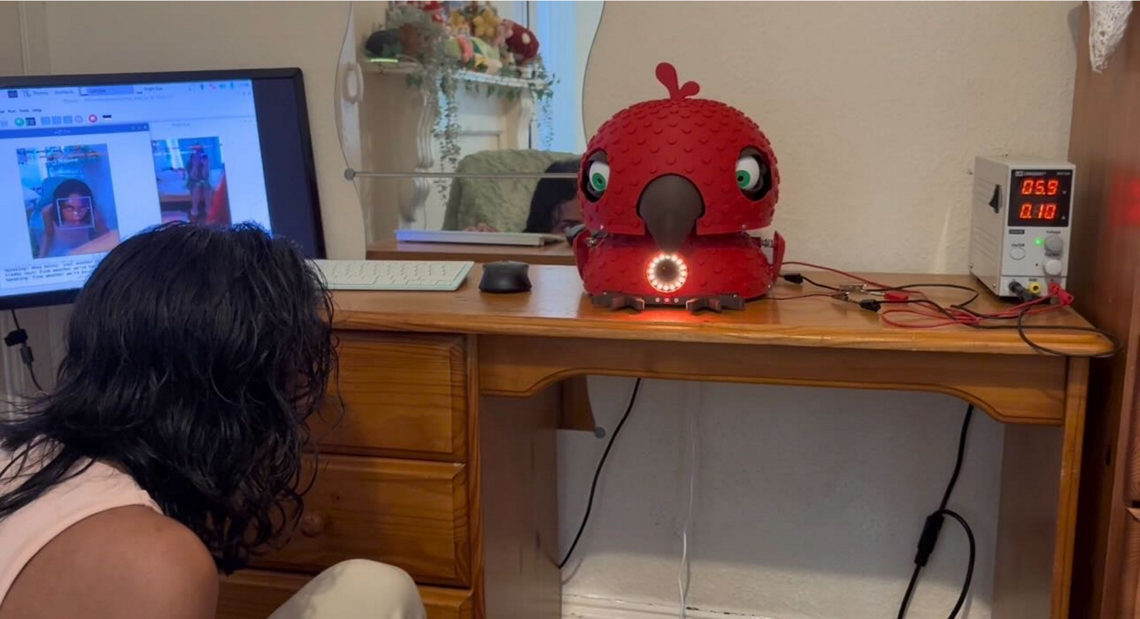
Project Aim
To create a characteristic animatronic robot that could:
track a person’s face
react to facial expressions
listen for “Hey Freddy”
repeat speech in a custom parrot voice
move eyes, eyelids, wings, neck, beak, and LEDs
Freddy was also designed to operate locally on the Raspberry Pi rather than relying on cloud services. This supported privacy, accessibility, and independence from internet connection.

Slide 3
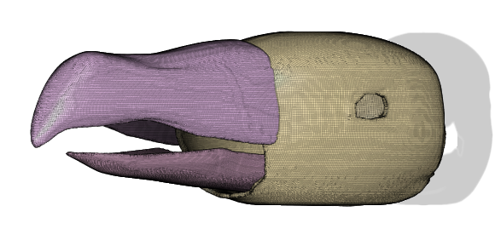
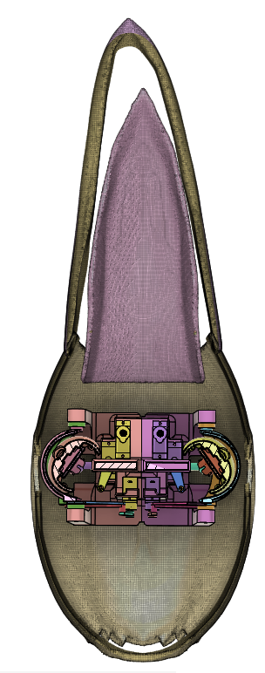
Original vs Final Deliverables
Proposal stage | Original target | Final outcome
Pass | Physical prototype of eyes, beak, covering, CAD simulation, 3D prints, fitment checks | Achieved and expanded into a full animatronic parrot body with eyes, eyelids, beak, wings, neck, covering, fitment checks, CAD simulations, and final assembly
2:2 | Servo calibration and programmed motion for blinking, eyeball movement, and beak actuation | Achieved, with additional servo-driven wings, neck movement, beak animation, eyelids, and emotion-based motion behaviours
2:1 | Person detection using ESP32-CAM modules and testing in different lighting | Achieved using Raspberry Pi 5 and dual Pi cameras instead of ESP32-CAMs, with MediaPipe face detection and testing under different lighting/movement conditions
First | Camera data mapped to servo movement for independent eye tracking, plus enhancements such as sound/beak synchronisation and expressive behaviour | Achieved and expanded: face tracking controlled eyes and neck, while additional systems included emotion recognition, wake-word detection, speech transcription, custom Piper voice, beak animation, LEDs, and parrot mode

Slide 4
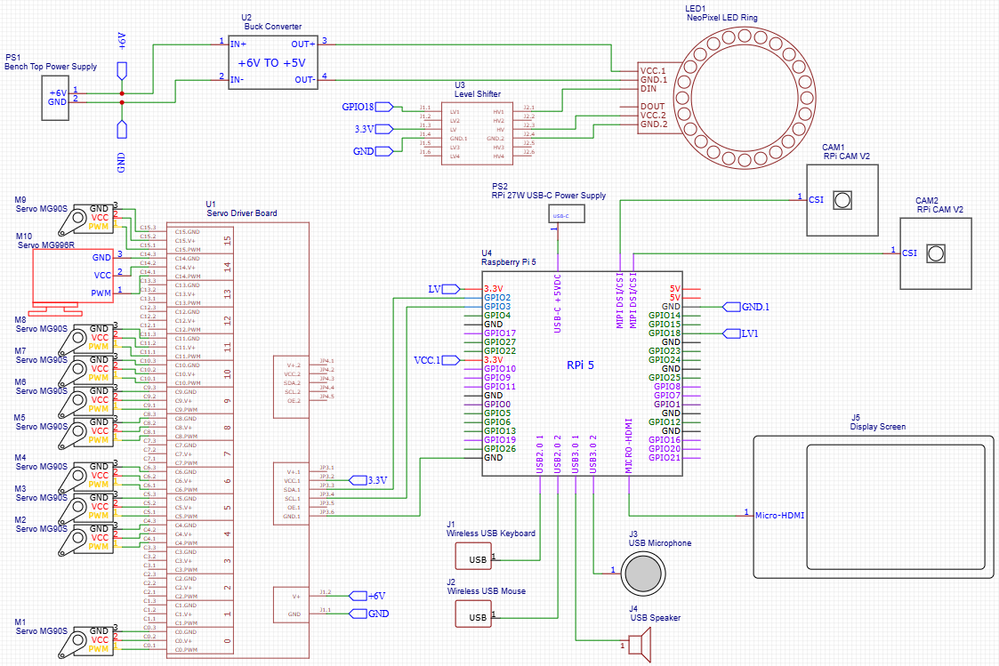

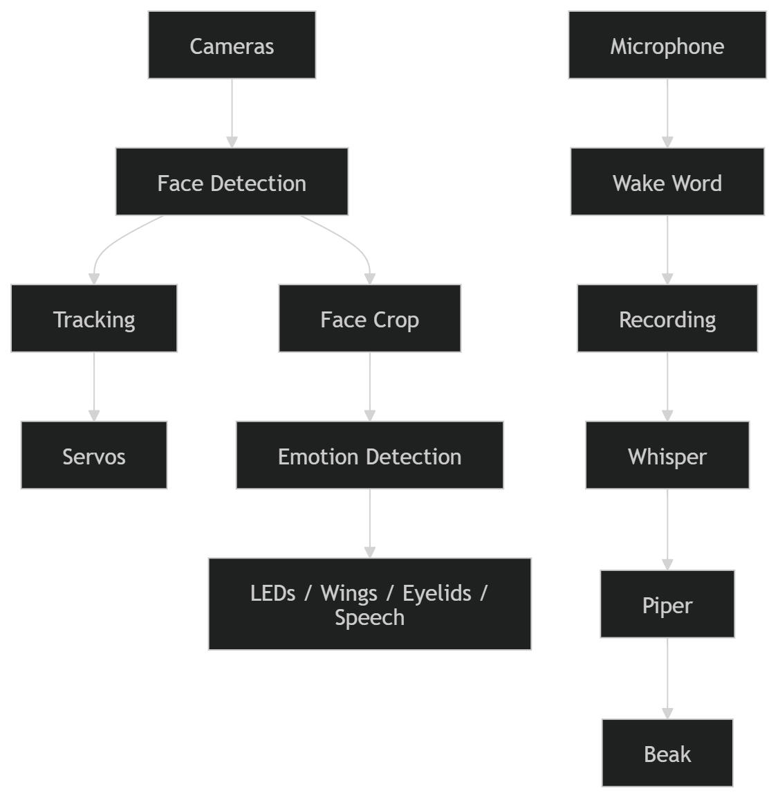
System Overview
Freddy was built around a Raspberry Pi 5, which coordinated the vision, audio, and motion subsystems. Key components included:
Two Raspberry Pi Camera Module 2 for face tracking
A PCA9685 driver board for servo control
Servos for the eyes, eyelids, beak, wings, and neck
A NeoPixel LED ring for emotion feedback
A microphone for wake-word detection and speech input
A speaker for audio output
Power regulation components including a buck converter
Bi-directional logic level shifter to convert Pi 3.3V data output to 5V

Slide 5
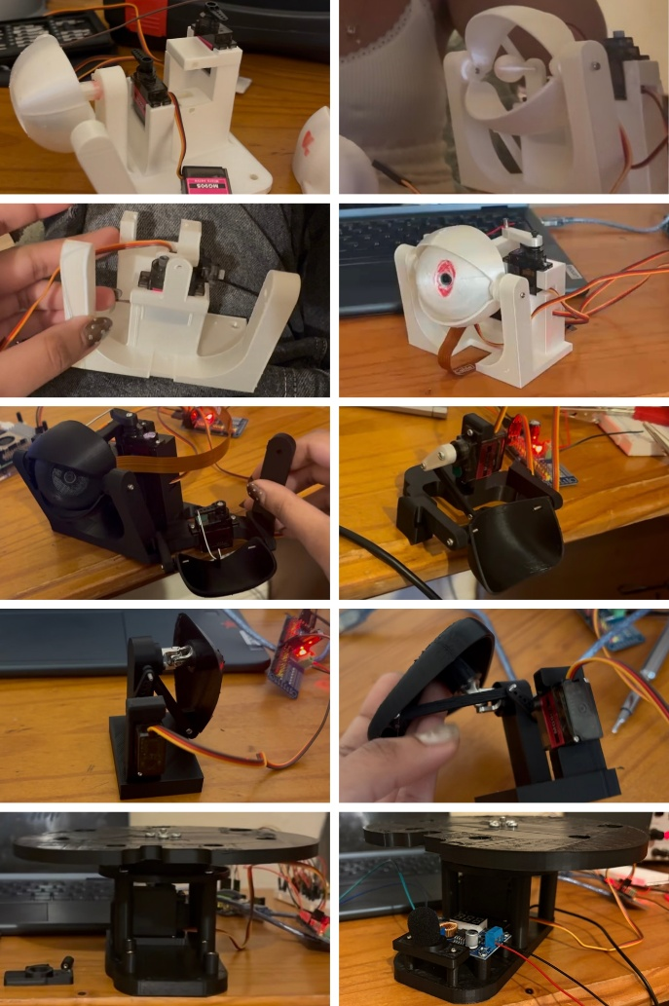
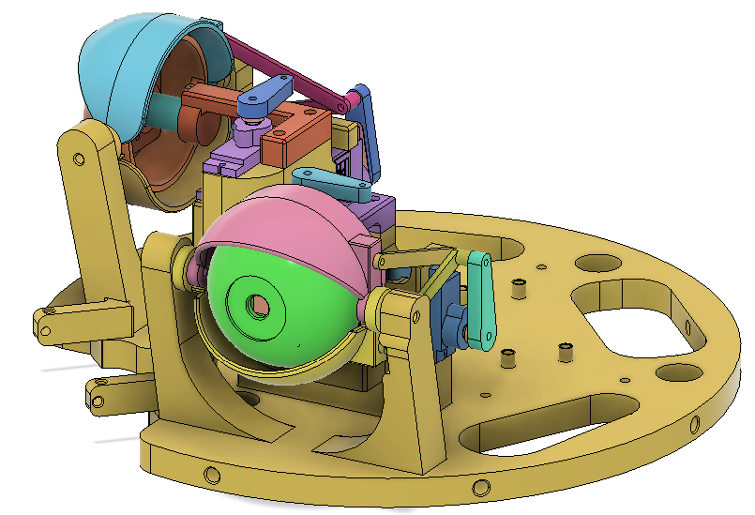
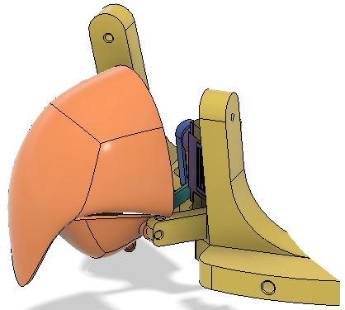
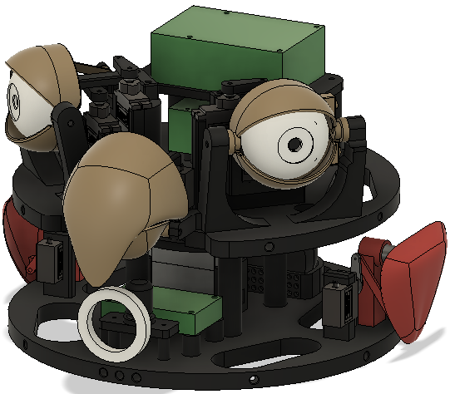
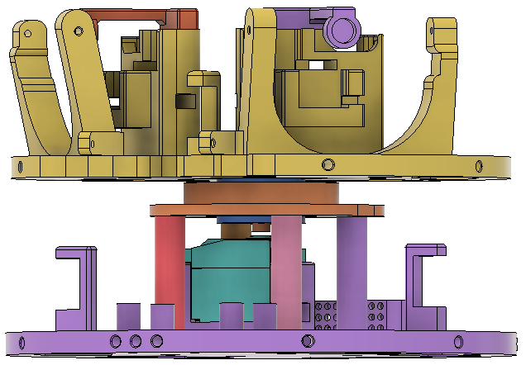
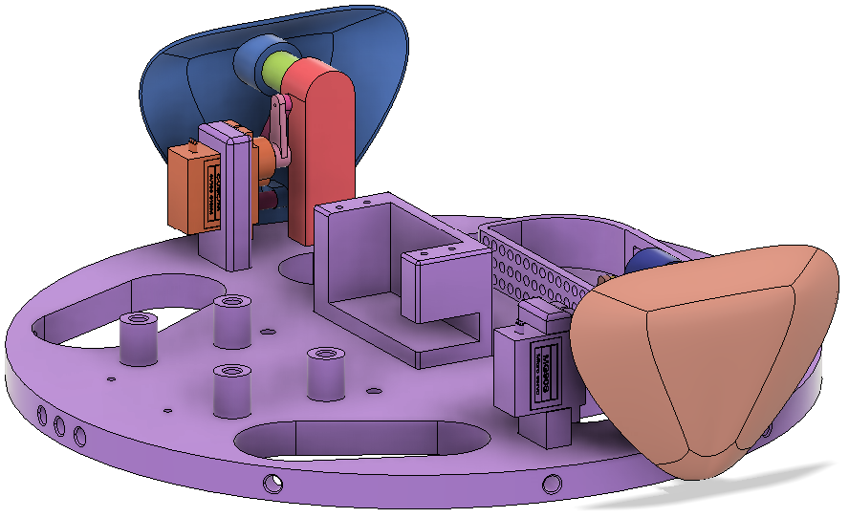
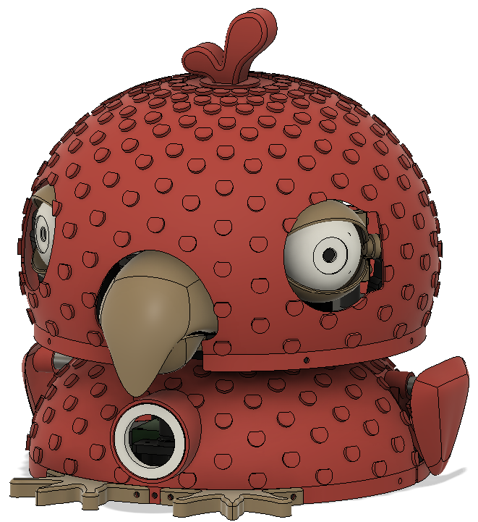
Mechanical Design
Freddy was design in Fusion 360 and 3D-print in PLA. Most parts were 3D printed and designed from scratch.
The design involved:
MG90S servo-driven eyes, eyelids, beak and wings
MG996R servo-driven neck
Mounts for the Pi, PCA9685, Speaker, Buck Convertor, Microphone
The design was the longest process as it involved lots of iteration through physical fitment tests.

Slide 6
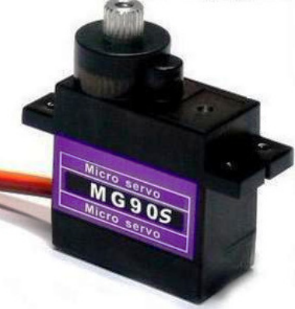
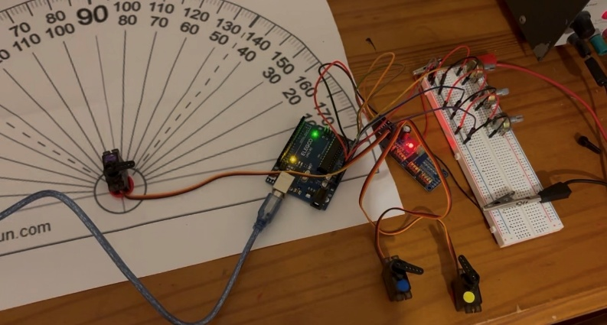
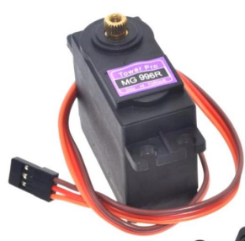
Servo Calibration
Since servos do not know their true position, they had to be calibrated using a protractor to determine 0-180° motion.
Pulse Width Modulation (PWM) tick limits for each mechanism had to be found experimentally. An Arduino UNO, PCA9685 and potentiometers were used to do this, and final calibrated values were transferred into Python on the Pi.

Slide 7
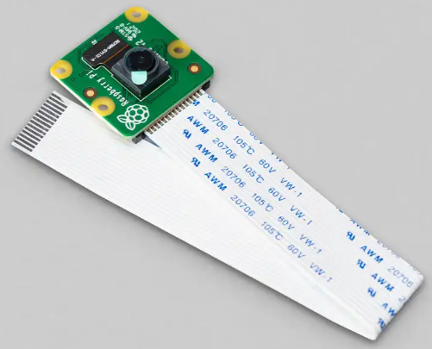
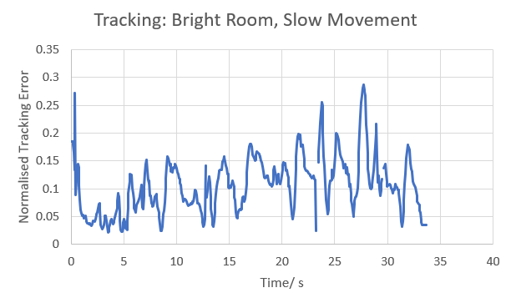
Face Tracking
Freddy uses the cameras mounted as pupils in its eyeballs to track. It incorporates active target selection, proportional-style tracking, deadzones to reduce jitter and scanning when no face is detected.
For face detection, MediaPipe, an open-source framework from Google, was used. When a face was detected in the camera frame, the code compared that position to the centre of the frame and then moved the eyes and neck to reduce the error between the two.
Testing:
With the confidence threshold = 0.5,
The tracking solution performed well with a normalised tracking error of 0.287 maximum and only 4 instances in which the face was not detected.

Slide 8
Emotion Recognition
Freddy uses another open-source framework for emotion recognition: HSEmotion, specifically the model, enet_b0_8_best_afew. He can detect 7 out of the 8 emotions: happy, sad, angry, disgust, fear, surprise, neutral.
timestamp | raw_prediction | stable_emotion
1777036530 | disgust | neutral
1777036531 | disgust | neutral
1777036532 | disgust | disgust
1777036533 | disgust | disgust
1777036534 | disgust | disgust
1777036535 | disgust | disgust
1777036536 | disgust | disgust
1777036537 | disgust | disgust
1777036538 | disgust | disgust
1777036539 | disgust | disgust
1777036540 | disgust | disgust
1777036541 | disgust | disgust
1777036542 | disgust | disgust
1777036543 | disgust | disgust
1777036544 | disgust | disgust
1777036545 | disgust | disgust
1777036546 | angry | disgust
1777036547 | disgust | disgust
1777036548 | disgust | disgust
1777036549 | disgust | disgust
Essentially, a cropped face is passed to the model, raw predictions could flicker but with a confidence threshold, majority voting, and stability timer, behaviour was smoother.
Testing:
← For an example of the stability working, this was a snippet of test data when detecting ‘disgust’.

Slide 9
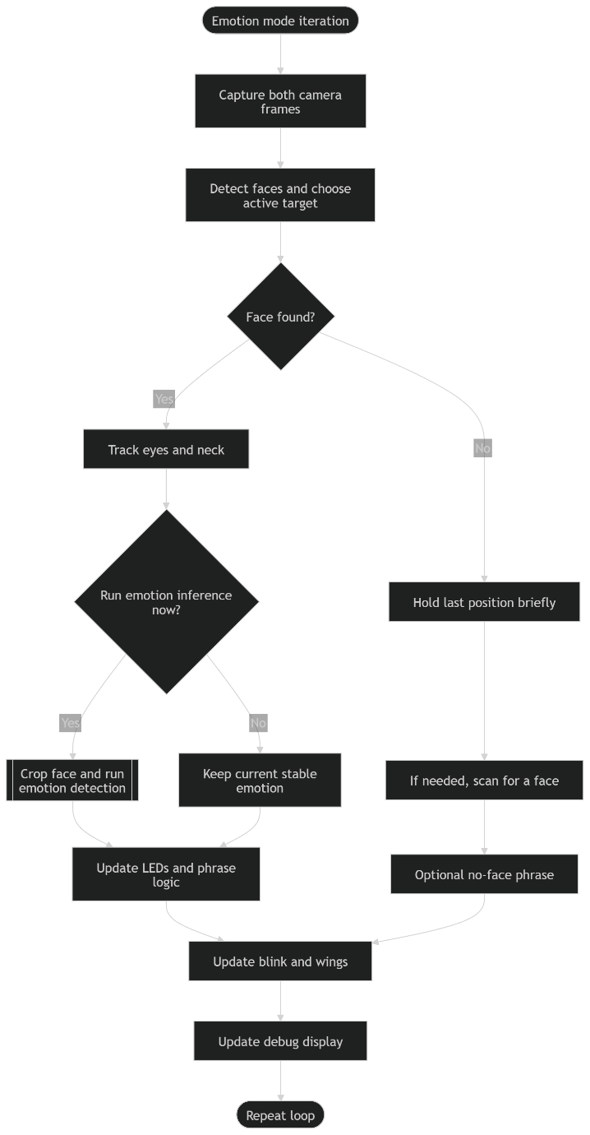
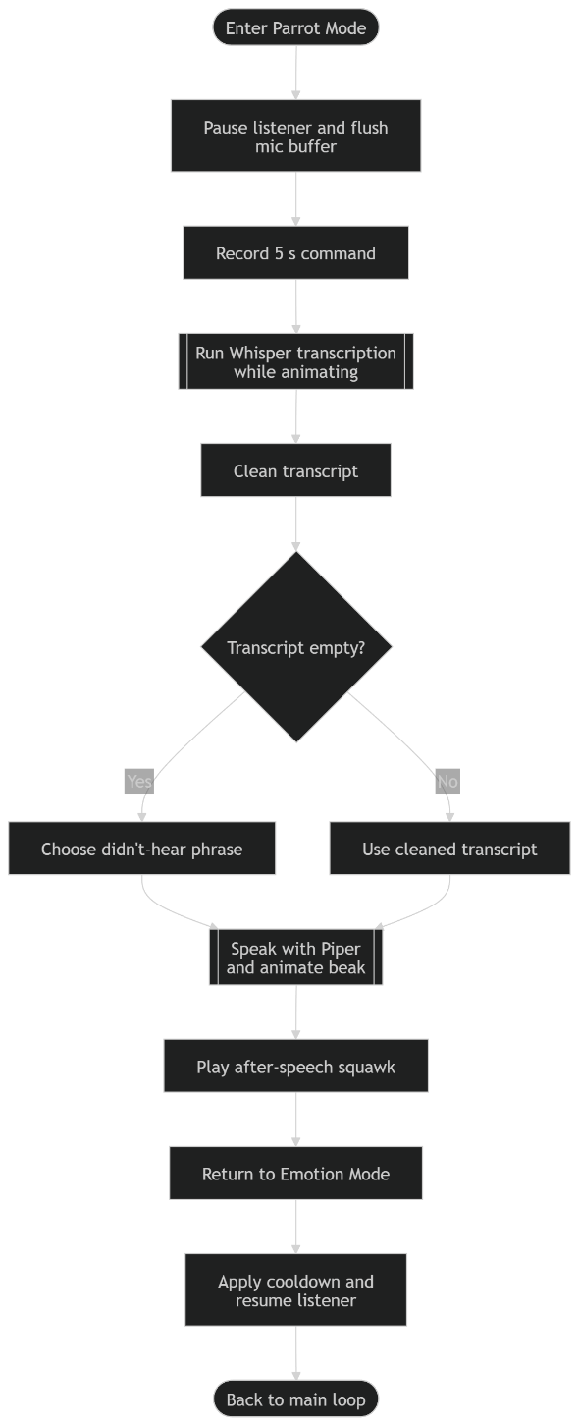
Modes
Freddy has two distinct modes of interaction:
Robot/ Emotion Mode: Freddy tracks the user’s face, recognises their emotion then responds with eyelid and wing movement, speech, and LED ring colour changes.
Parrot Mode: Freddy listens for the wake-word, “Hey Freddy”, transcribes spoken input with Whsiper STT, translates it into English, and repeats it aloud with Piper TTS.
Testing:
A big challenge with Freddy being local and offline, meant that latency was a potential issue. After testing, the Base Whisper Model was found to perform best in terms of balancing accuracy and latency, performing at 73% English transcription accuracy and approximately 4s transcription time.
Translation was still quite inaccurate though with a 30% accuracy.

Slide 10
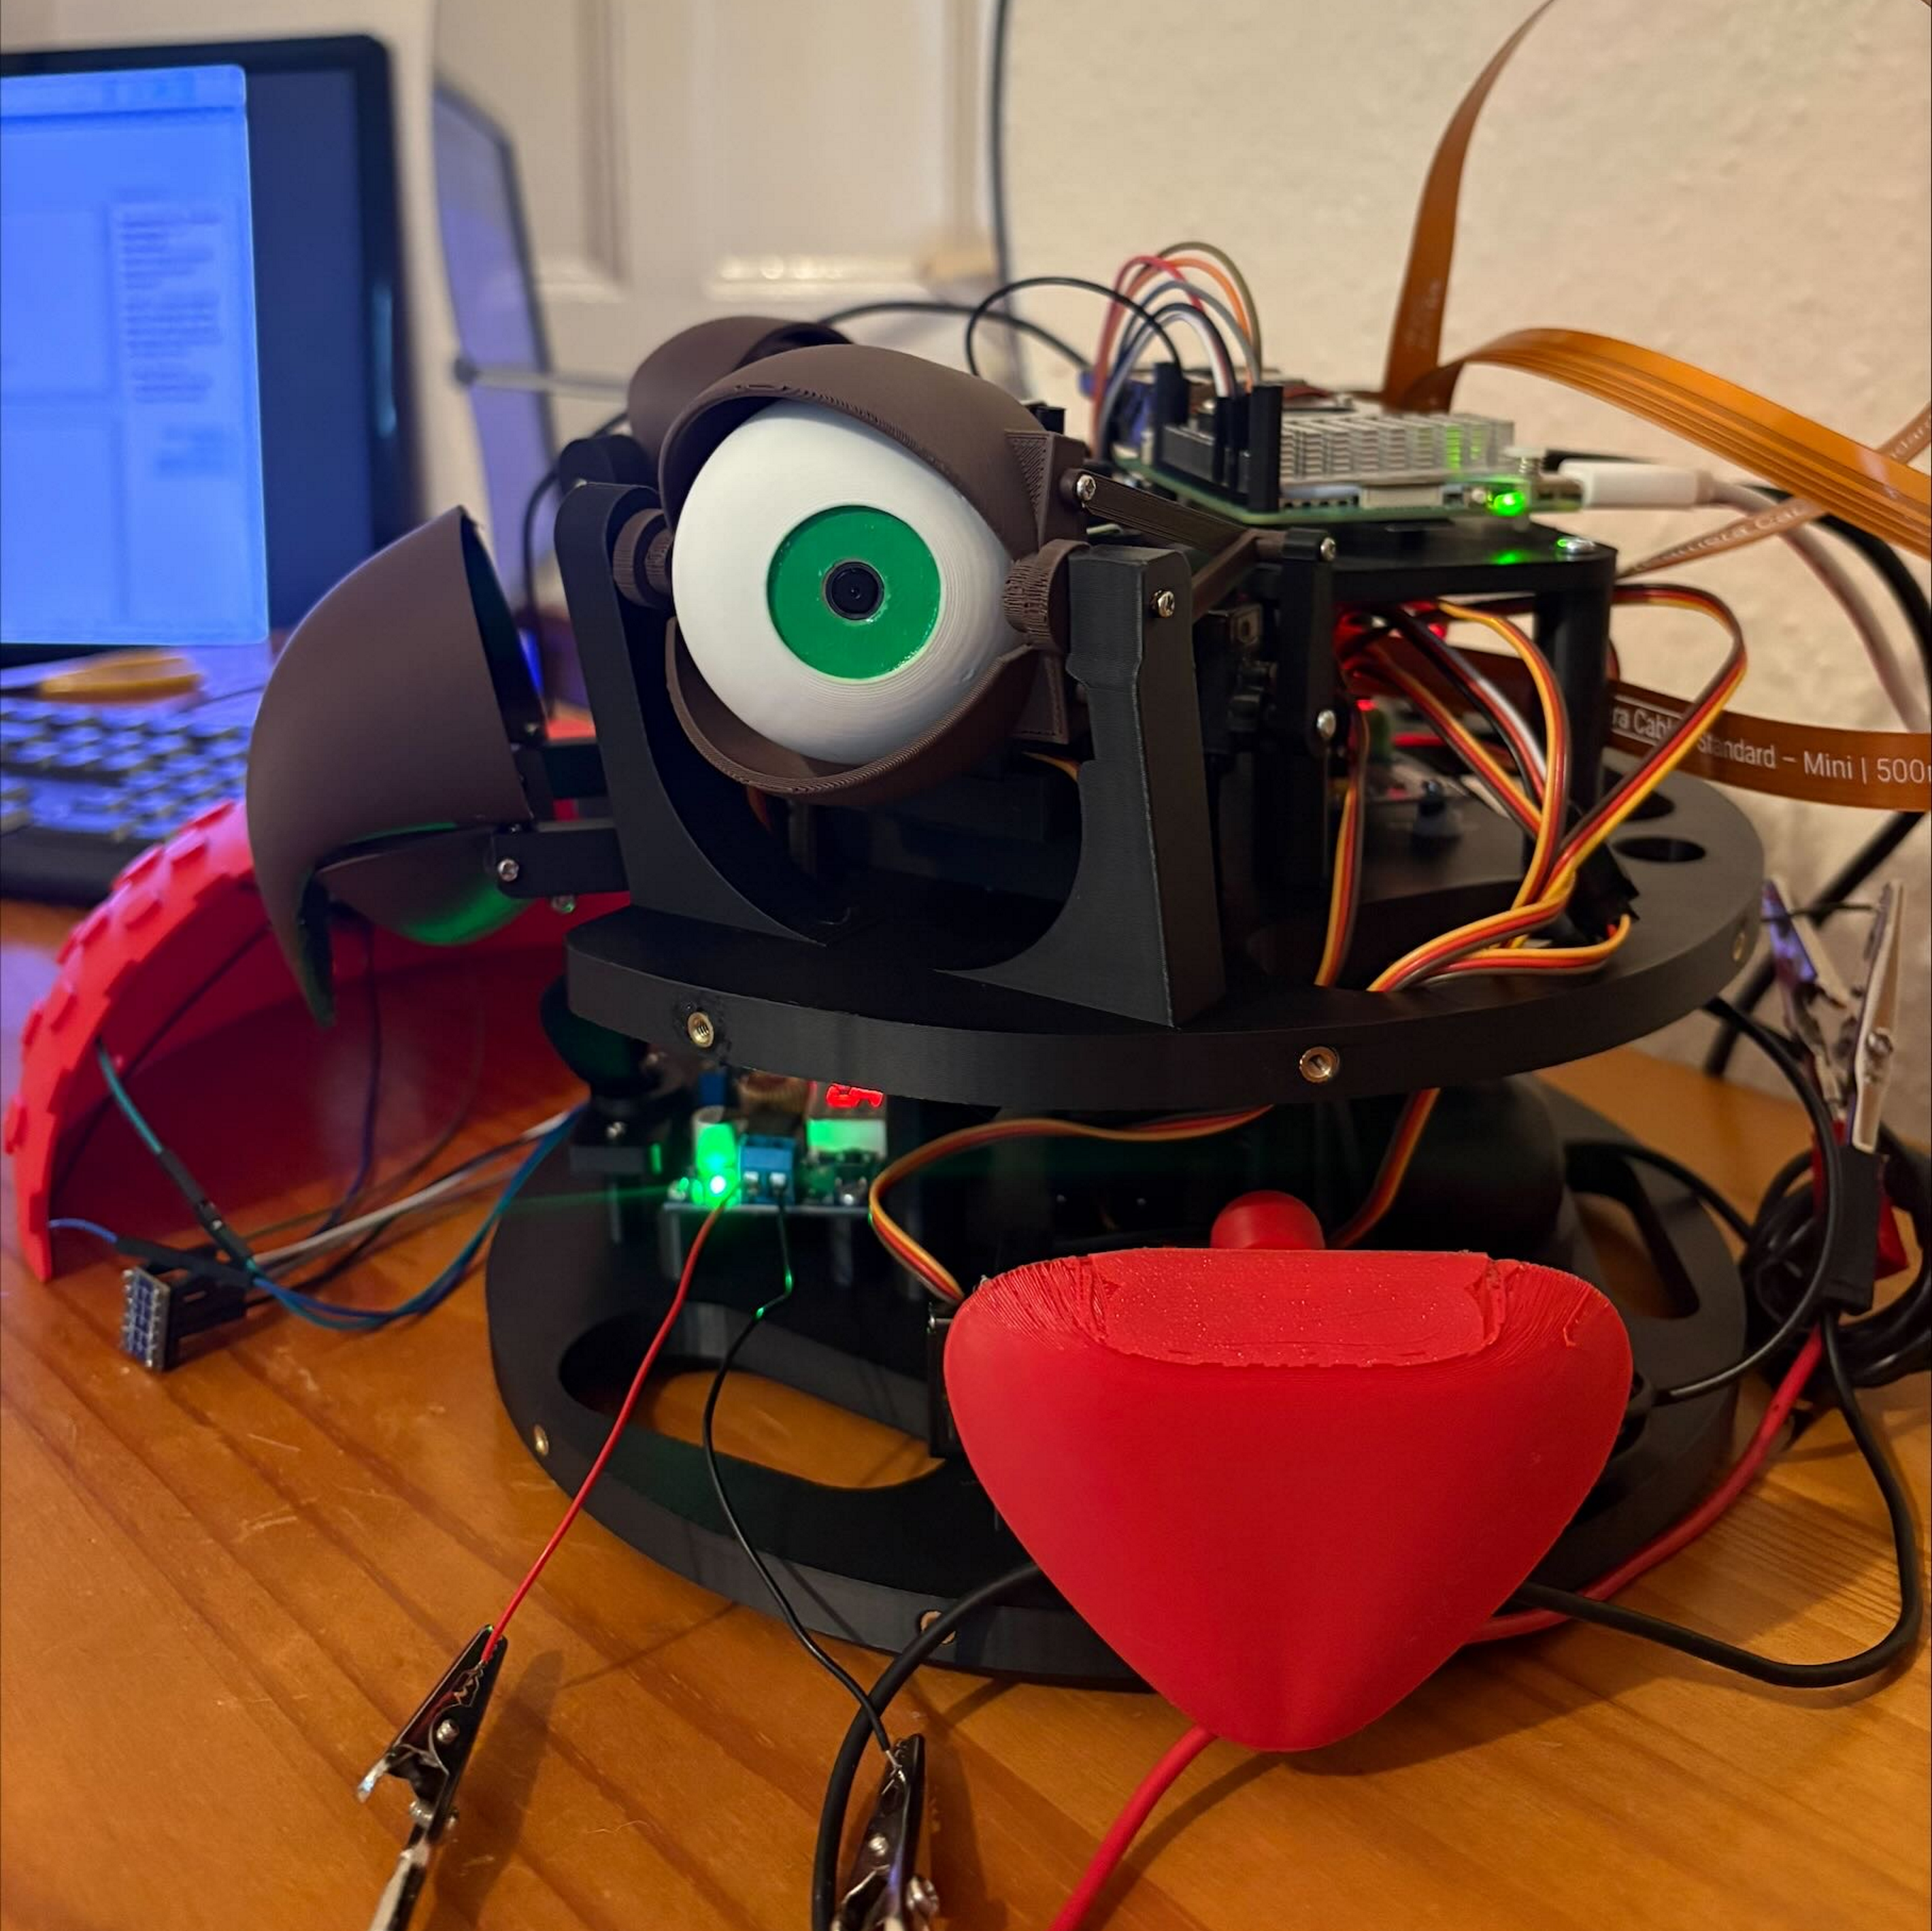
Custom Voice
ElevenLabs used was to establish desired voice style
Chatterbox TTS was used to generated 1500 training clips from a metadata.csv file using the selected voice
Training clips were manually checked
An open-source framework, TextyMcSpeechy, was used to train the custom Piper voice for 5 hours
Final voice model ran locally and offline

Slide 11
Wake-word Detection
A framework called by Picovoice called Porcupine was used to generate the custom wake-word model, ‘Hey Freddy’.
Testing: A sensitivity of 0.8 worked well for detection but false positives still existed with a 30% false positive detection rate.

Slide 12
Why these models?
Component | Chosen option | Why
Face detection | MediaPipe | lightweight, real-time, gives bounding boxes
Emotion | HSEmotion | pre-trained, easier than training from scratch
STT | Whisper Base | best accuracy/ latency compromise
TTS | Piper | lightweight, local/ offline TTS
Wake word | Porcupine | more reliable than openWakeWord which was previously used

Slide 13

Challenges
Integrating many threaded subsystems: race conditions
Servo calibration: tedious
Cable routing issue: restricting neck motion
Custom voice training: time-consuming
Debugging hardware/ software together: figuring out whether servo jitter was code-related or a mechanical issue
False wake-word triggers
Latency and poor translation

Slide 14

What I Learned
New aspects about Fusion 360 CAD: forms, motion studies, tolerances, drawings
How to use a 3D-printer: fitment check
How to use a Raspberry Pi for a robotics project
Linux, virtual environments, terminal commands, and dependency installation
Experience in integrating pre-trained ML models
Improved confidence in handling unfamiliar technical problems

Slide 15
Future Improvements
Get a better microphone
AI accelerator HAT for faster offline models
Modular code structure rather than one giant script
Raspberry Pi-based servo calibration script
Better neck cable routing
Physical start/ stop button
Belly LCD display for transcription/ status
Voice activity detection instead of fixed 5s recording
Possible local LLM for replies instead of pre-determined phrases

Slide 16
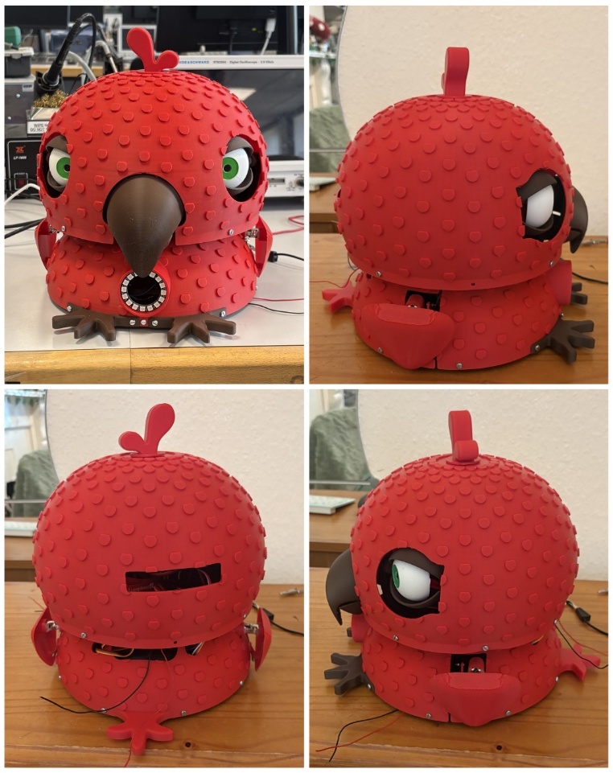
Demo

Slide 17
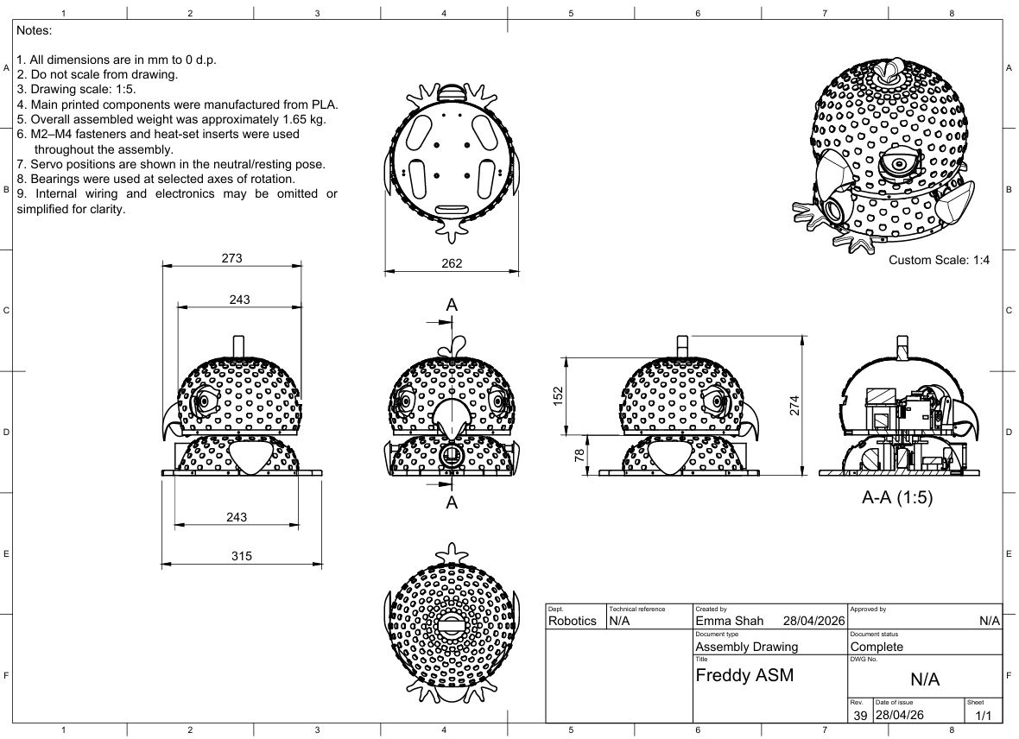
Feedback
If you have any questions, please do let me know!

Slide 18

THANK YOU
Emma Shah

